Slide 1
Online voting system via mobile

Slide 2
Abstract:
In today’s world of growing advanced mobile technologies, the traditional voting method can be changed to a newer and effective approach termed as mobile voting. The Mobile voting system provides a convenient, easy and efficient way to vote eliminating the shortcomings of traditional approach. In this paper we propose to build an E-Voting system which is basically an online voting system through which people can cast their vote through their smart phones or by using an e-voting website. To achieve the required security we are using OTP (one time password) approach, which is most commonly on the web to tell the difference between a human using a web service and an automated bot thus making the website more secure against spam- bot attacks. If the results of the matching algorithm are three point match then checks whether this person own voter ID after that it will check with AADHAAR ID, If he has the right to vote then a voting form is presented to him, and the third level of authentication is carried out by using One Time Password (OTP) principle. Nowadays Technology is being used more and more as a tool to contribution voters to cast their votes. To allow the use of this right, almost all voting systems around the world contain the following steps: Voter identification and authentication, voting and recording of votes cast, vote counting, publication of election results.

Slide 3
INTRODUCTION
The project Online Voting system is designed to count the number of votes and thereby calculate the percentage of votes. Also the number of vote a candidate obtains is also obtained. Along with the number the percentage of votes for each candidate is calculated. The system is so designed that it can also check for duplication. It then decides the winner in every section. The project is designed with a modular approach and the number of modules is decided as per the requirements of the organization. The two modules are administrator module and the user module. The administrator has total authority of the organization and maintains all the aspects. The user has the provision to view the list of all candidates and results as well as vote for the desired candidates. The development in mobile device, wireless, android technologies and data communication result in view application that will make voting process easier and efficient e-voting system can cast and count votes with higher convenience and efficiency which even reduces misteks rate of ballot examination

Slide 4
Existing System
Existing System consist of methods like paper based voting, Lever voting machine, Punch card and Optical voting machine. The main problem with existing system was time consuming which used to take lot of time for voting. Paper based voting method was used in existing system which also gave the results of fake voting.

Slide 5
Proposed System
This system has overcome the problems of existing system
Saved Ballot Templates : Eliminate the need to configure elections from scratch. Just do it once, then save that ballot configuration, and in subsequent years, specify only the names of the candidates.
Reduced costs: Are enjoyed when the expenses of printing, mailing and tabulating paper ballots are lessened or even eliminated entirely from the election process.

Slide 6
LITERATURE REVIEW
In , the author Kohno T., Stubblefield A., Rubin A. and Wallach D. S, (2004), describes the security features of the electronic voting system and e-voting system is better than manual voting system. Also, the author shows that voters, without any insider privileges can cast unlimited votes without being detected by any mechanisms within the voting terminal software. In , the author CiprianStănică- Ezeanu (2008) reviewed evoting procedure by describing its advantages and disadvantages. His work was majorly on the security measures such as firewalls or SSL communications which are necessary but not sufficient to guarantee the specific security requirements of e-voting. Also, the author describes the additional layer of Performance Improvement using Pseudorandom One Time Password (OTP) in Online Voting System .specialize security technology to address the specific risks posed by electronic voting and guarantee critical security requirements such as voters’ privacy, vote integrity and voterverifiability. The author equally suggested the use of Biometrics and smartcard for authenticating users. One major issue the author stressed out is the difference between biometric and “classic” authentication like smart cards. The evoting system proposed. in does not interact in any way with the biometric characteristics of the actual users, but still authenticates the user with the help of the user’s authentication certificate on the smart card. In ,Manish K, Suresh K.T, Hanumanthappa. M, Evangelin G.D (2005) the author specified mainly on securing the voting system, by manual voting system to that of the electronic voting system.
Authors Rossler T.G (2011). In suggested the use of Remote Internet Voting, with a view to enhance voter convenience, increase voter confidence and voter turnout. In the survey, authors suggested remote poll-site electronic voting as the best step forward as it provides better voter convenience, but at the same time, does not compromise security. In , the author Avi Rubin (2001) review the security measures needed for remote online voting system by focusing on two cases where voters cast their ballots over the Internet – the 2000 Arizona Democratic Primary and the University of Virginia Student Council Elections. The author claims that a secure voting system must thoroughly satisfy four major requirements: authentication, availability, confidentiality and integrity

Slide 7
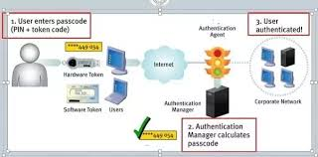
PROPOSED IMPLEMENTATION
1. The Online Voting should Be able to display all registered voters in the database to the SYSTEM ADMIN(s) as per their access rights and privileges. Have a user-friendly interface and user guides understandable by people of average computer skills. Be robust enough so that users do not corrupt it in the event of voting. Be able to handle multiple users at the same time and with the same efficiency, this will cater for the large and ever growing population of voters. 2. OTP The Main Security implementation of our project is the concept of One Time Password i.e. every time a new password is generated and sent to the user on his mobile phone. One Time Password is a Random 6 Digit Number that changes every time, whenever user logs on to the system and performs some transaction.

Slide 8
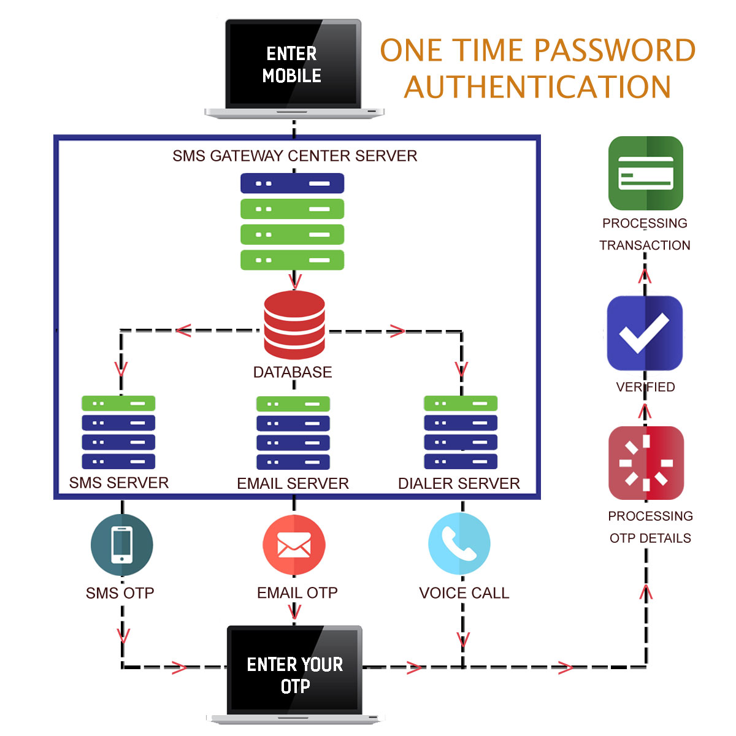
The Concept has been implemented in such a way that it adds high level of security to our online voting system

Slide 9
The Flow chart of the mobile voting shows the sequential flow of how the data passes from one activity to another. It starts from Registration, Login and Forgot password .The Fig 2 shows the initial screen when the application starts. It has the login form, registration and forgot password and then continues 3 .Registration This option is used when the user is first registering through the application. It will take them to a registration screen. 4 .Login This option allows us to log us in for voting. 5 .Result Activity The task of voter registration is strictly preserved for the system administrator. Therefore if you are logged in as a mere user/voter, you don’t have this privilege, therefore, the registration page link is disabled for you. 6 .OTP Activity The task of OTP (one time password) is to send a mobile phone on the registered mobile after logging in the account, so that we can cast vote only after we are authorized to do so by the OTP sends us a random message on our mobile an random number and then we can insert the number to vote. 7. Voting Activity After voting, a voter is allowed to check the results by visiting the results page.

Slide 10
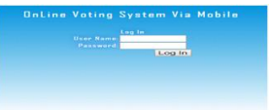
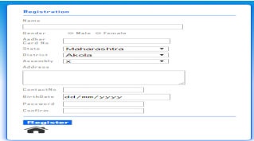
RESULT
The proposed Online Voting System with OTP scheme is described in this section. In this proposed method we will commence the work with database creation. In order to create the database we collect the voter detail from different voters as shown in the figures.
Voter Registration Form
New Voter Login Form With Authorized Aadhaar Id and Password

Slide 11
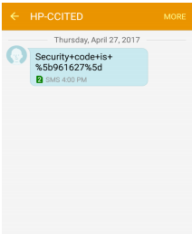
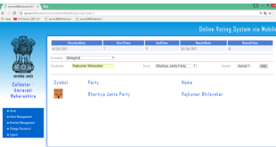
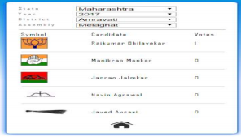
Access OTP on Registered Mobile for Voter Verification and Vote
CandidateRegistration through Admin
. Decleration of Election

Slide 12
ADVANTAGES
The system can be used anytime and from anywhere by the Voters. No one can cast votes on behalf of others and multiple times. Saves time and reduces human intervention. The system is flexible and secured to be used. Unique Identification of voter through Aadhar number/Voter-ID. Extremely secure system with one time password. Improves voting with friendly Android Interface. No fraud vote can be submitted.

Slide 13
CONCLUSION
In Present time, OTP (one time password) applications are increased. Security is an important issue for handling such services. Current system provide security card based facility to authenticate user but this is not secure enough and may not be available on any time or situation. To overcome such type of issues we propose online e-Voting authentication system using
OTP with aadhaar id and pseudorandom number generator that identification is too complex which is improving the security for brute force attack. The practicable future scope of the project includes the improvement in the security level of the system. In annexation to that it would be interesting to meet some other confidential primitives to improve the security level of online voting system online voting systems have many advantages over the traditional voting system. Some of these advantages are less cost, faster generation results, easy accessibility, accuracy, and low risk of human and mechanical errors.

Slide 14
FUTURE SCOPE
The Online Voting System (OVS) platform can be made more secure by using the following methods Password Changing Fingerprinting Cornea Detection The password used by the user to vote is provided by the administrator. In the future the user can be given the privilege of changing the password. So it helps to increase the security of the system. The other two methods that can be used are cornea detection and fingerprinting. But here the problem is that it decreases the scope of the platform because these systems need some electronic components to implement. So it will avoid the user’s privilege to cast the votes at their fingertips. But it can guarantee that fake voting will be impossible.

Slide 15
THANK YOU

